Slide 1
Introduction to Database

Slide 2

MySQL
A free-to-use, open-source RDBMS developed by Oracle that is based on structured query language (SQL).
Used with the combination of PHP and Apache Web Server, on top of a Linux distribution.
Provides many features and benefits such as:
Data Security
On-Demand Scalability
High Performance
Notes:
1. Data Security
MySQL is globally renowned for being the most secure and reliable database management system used in popular web applications like WordPress, Drupal, Joomla, Facebook and Twitter.
2. On-Demand Scalability
MySQL offers unmatched scalability to facilitate the management of deeply embedded apps using a smaller footprint even in massive warehouses that stack terabytes of data.
3. High Performance
MySQL is designed to meet even the most demanding applications while ensuring optimum speed, full-text indexes and unique memory caches for enhanced performance.

Slide 3
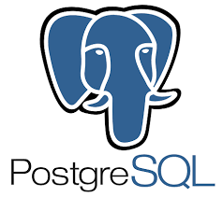
PostgreSQL
An advanced, enterprise-class, and open-source object-relational database management system.
Supports both SQL (relational) and JSON (non-relational) querying.
Supports advanced data types and performance optimization features, which are only available in expensive commercial databases.

Slide 4
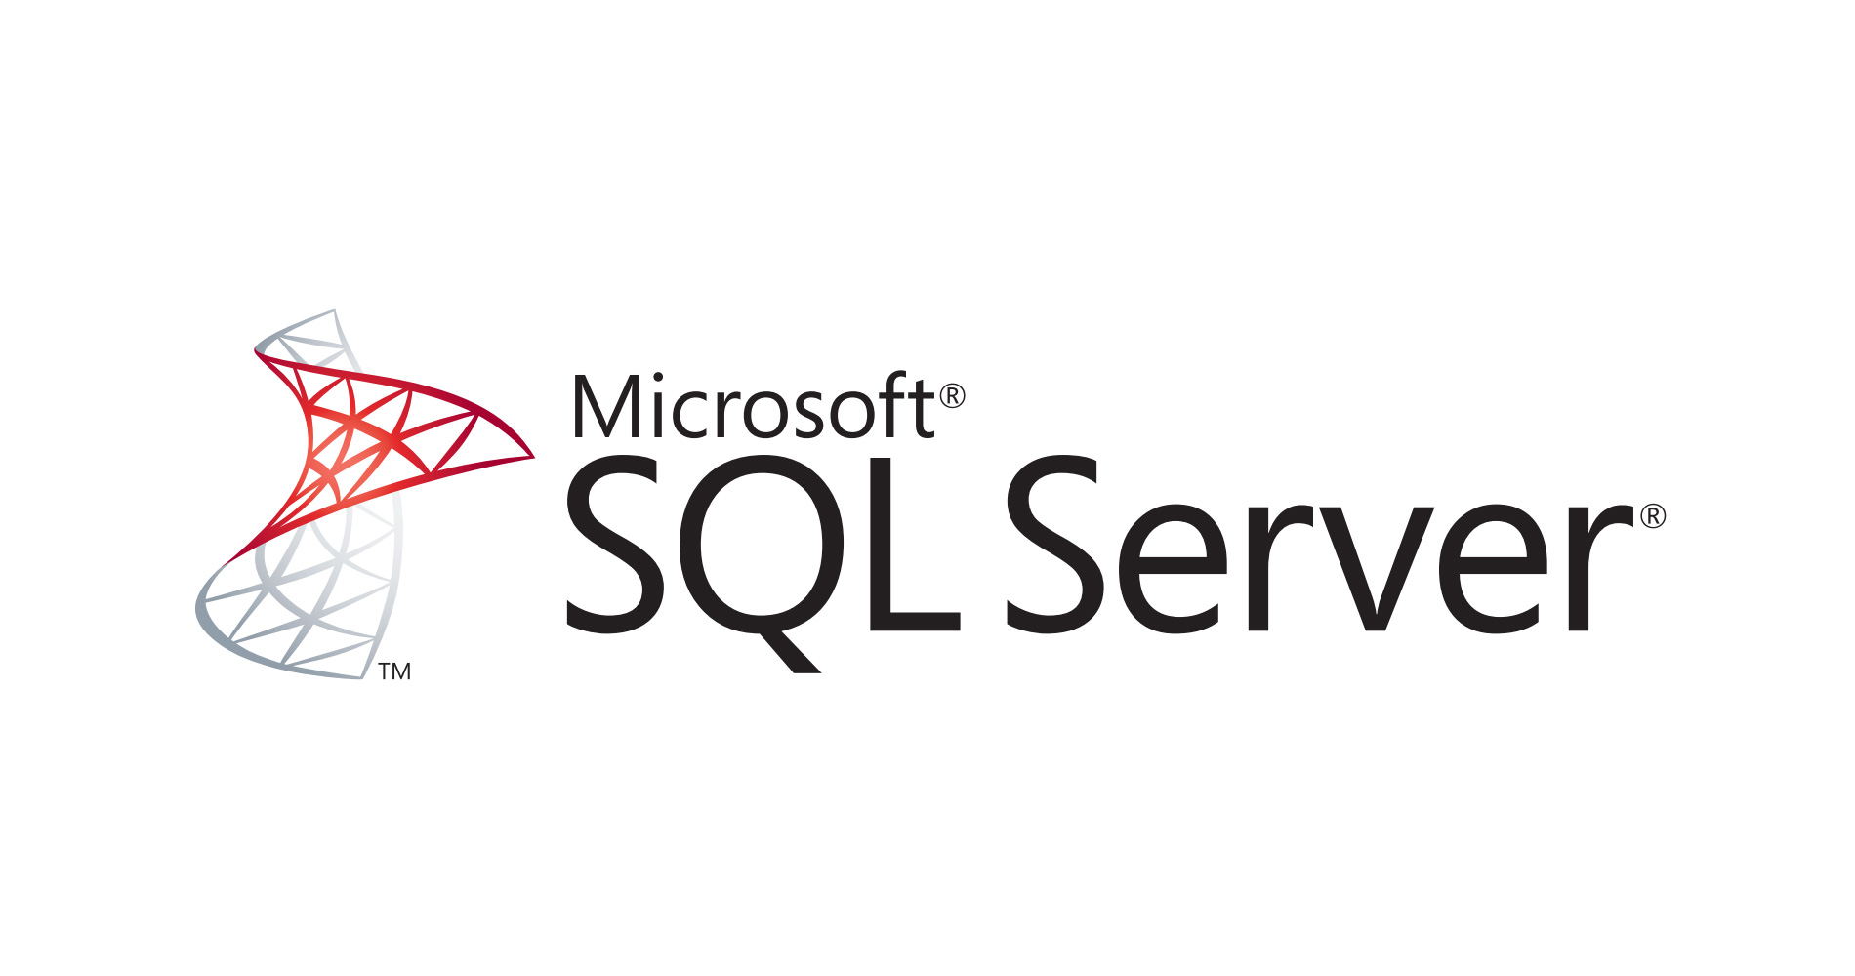
SQL Server
A relational database management system (RDBMS) developed by Microsoft.
It is primarily designed and developed to compete with MySQL and Oracle database.
SQL Server comes with its own implementation of the SQL language, T-SQL (Transact-SQL).
T-SQL is a Microsoft propriety Language that provides further capabilities of declaring variable, exception handling, stored procedure, etc.

Slide 5
MySQL vs PostgreSQL vs SQL Server
MySQL | PostgreSQL | SQL Server
Developed by MySQL AB (Now Owned by Oracle) | Developed by PostgreSQL Global Development Group | Developed by Microsoft
A relational based DBMS | An object based relational DBMS | An object based relational DBMS
Open source. Freely available. | Open source. Freely available. | Not free
Uses SQL | Uses SQL | Uses T-SQL (Transact SQL)
Expects less amount of operational storage space. |  | Expects a large amount of operational storage space.
Doesn’t allow query cancellation mid-way in the process. |  | Enables stopping query execution
Allows database file manipulation while running. |  | Highly secured and doesn’t allow any kind of database file manipulation while running.
Only supports Standard data types | Support Advanced data types | Support Advanced data types

Slide 6
Thank you

